Slide 1


Machine Learning
Prof. Manisha
Manisha@careernow.us

Slide 2
Clustering Introduction

Slide 3

Clustering is the task of dividing the unlabeled data or data points into different clusters such that similar data points fall in the same cluster than those that differ from the others. In simple words, the clustering process aims to segregate groups with similar traits and assign them into clusters.
It reveals subgroups in the available heterogeneous datasets such that every individual cluster has greater homogeneity than the whole. In simpler words, these clusters are groups of like objects that differ from the objects in other clusters.
In clustering, the machine learns the attributes and trends by itself without any provided input-output mapping. The clustering algorithms extract patterns and inferences from the type of data objects and then make discrete classes of clustering them suitably.

Slide 4

Imagine you're a librarian in a massive library, and you need to organize a vast collection of books into different sections based on their topics. However, you're not quite sure how to group them because there are so many different subjects. This is where clustering in machine learning comes in handy!
Clustering is like being a detective trying to solve a mystery. You have a bunch of clues (data points), but you're not exactly sure how they all fit together. Your goal is to uncover patterns and group similar clues together.

Slide 5
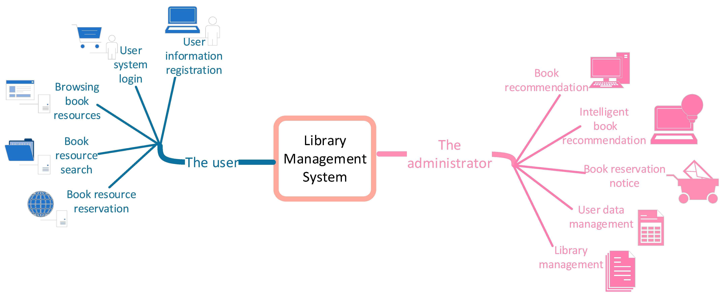
Data Collection
Similarity Measurement
Grouping into Clusters
Cluster Analysis
Evaluating and Refining

Slide 6
Now, let's add some calculations to the mix
Let's say you have 100 books, and you've decided to group them into 5 clusters. You compare each book to every other book and measure their similarity on a scale from 0 to 1, where 1 means they're the same.
Book A: Mystery
Book B: Mystery
Book C: Science Fiction
You might measure the similarity between Book A and Book B as 0.9 (because they're both mysteries), and the similarity between Book A and Book C as 0.2 (because they're different genres).
After comparing all the books, you start clustering them:
Cluster 1: Mystery (Books A, B, D, F, ...)
Cluster 2: Science Fiction (Books C, G, H, ...)
Cluster 3: Romance (Books E, I, J, ...)
Cluster 4: Thriller (Books K, L, M, ...)
Cluster 5: Fantasy (Books N, O, P, ...)

Slide 7
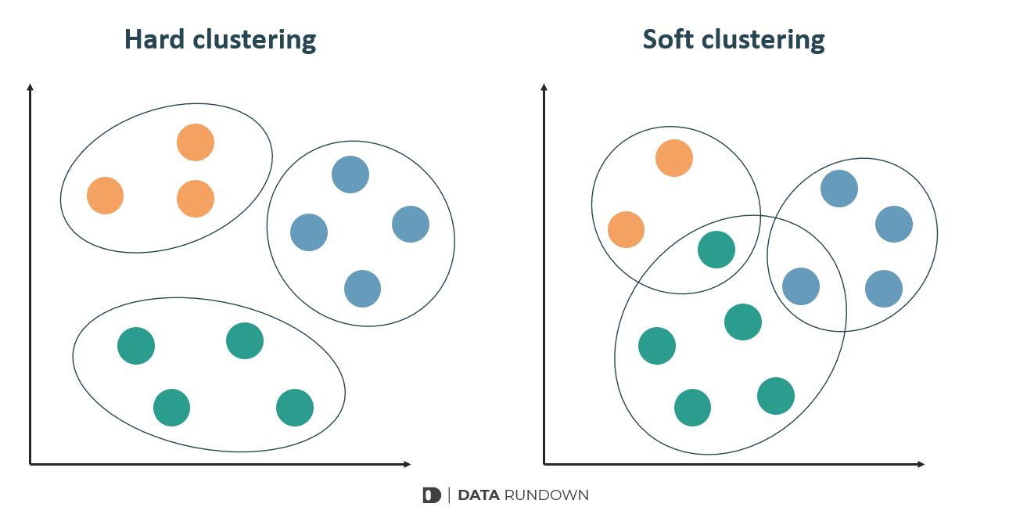
Types of Clustering Method

Slide 8
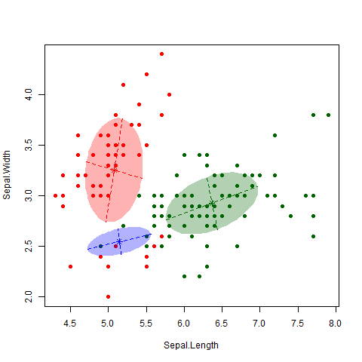
Types of Clustering Method
Hard Clustering: In hard clustering, each data point belongs exclusively to one cluster. There is no overlap between clusters, and each data point is assigned to the cluster with the closest centroid or representative point.
Soft Clustering (Fuzzy Clustering): In soft clustering, also known as fuzzy clustering, data points can belong to multiple clusters with varying degrees of membership. Instead of assigning a data point to just one cluster, soft clustering assigns a membership value indicating the likelihood of the data point belonging to each cluster.

Slide 9
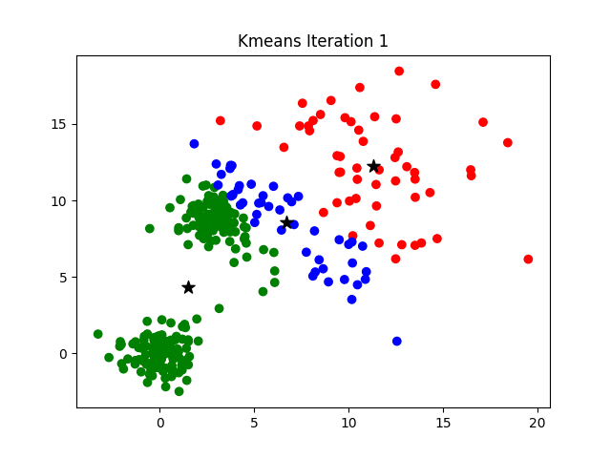

Types of Clustering Algorithm
K-Means Clustering: This is one of the most popular and widely used clustering algorithms. It's a hard clustering method where you specify the number of clusters (K), and the algorithm iteratively assigns data points to the nearest cluster centroid and then recalculates the centroids until convergence.
Hierarchical Clustering: This method creates a hierarchy of clusters by either starting with each data point as its cluster (bottom-up approach) or starting with all data points in one cluster (top-down approach) and iteratively merging or splitting clusters based on their similarity until the desired number of clusters is reached.

Slide 10

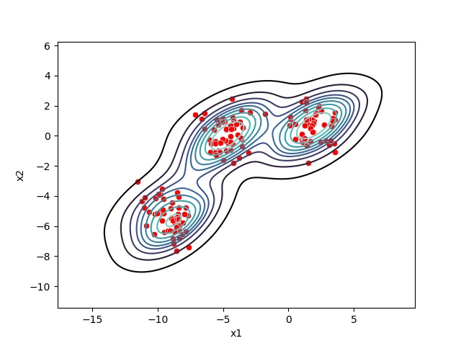
Types of Clustering Algorithm
DBSCAN (Density-Based Spatial Clustering of Applications with Noise): DBSCAN is a density-based clustering algorithm that groups data points that are closely packed together, forming high-density regions, and separating regions of low density. It's particularly useful for datasets with irregular shapes and noise.
Mean Shift Clustering: This is a non-parametric clustering algorithm that doesn't require specifying the number of clusters beforehand. It works by iteratively shifting data points towards the mode of the data distribution until convergence, effectively identifying clusters as regions of high data density.

Slide 11
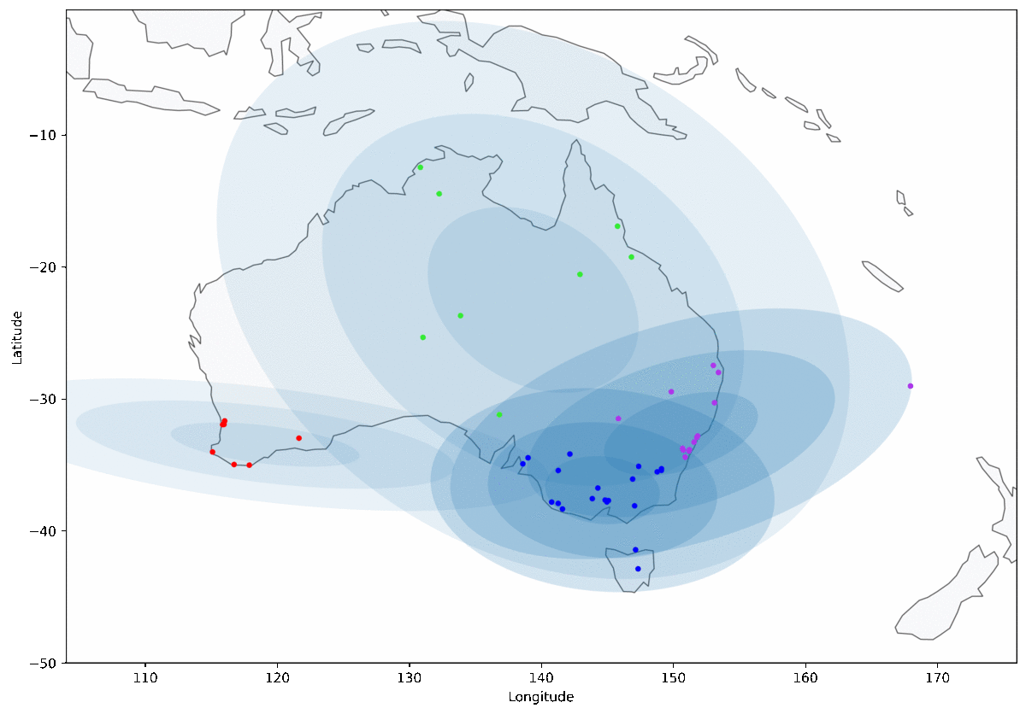
Types of Clustering Algorithm
Gaussian Mixture Models (GMM): GMM is a probabilistic model that assumes data points are generated from a mixture of several Gaussian distributions. It's a soft clustering algorithm that estimates the parameters of these Gaussian distributions to assign data points to clusters based on their probabilities of belonging to each cluster.
Agglomerative Clustering: This hierarchical clustering algorithm starts with each data point as its cluster and iteratively merges the closest pairs of clusters until only a specified number of clusters remain. The distance between clusters can be measured in various ways, such as Euclidean distance or Manhattan distance.

Slide 12
Clustering K-Means

Slide 13
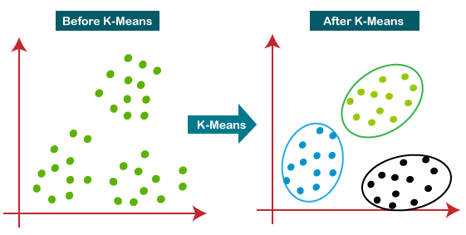
“K-means clustering is a method of vector quantization, originally from signal processing, that aims to partition n observations into k clusters in which each observation belongs to the cluster with the nearest mean, serving as a prototype of the cluster.” –
K-means is a centroid-based clustering algorithm, where we calculate the distance between each data point and a centroid to assign it to a cluster. The goal is to identify the K number of groups in the dataset.
It is an iterative process of assigning each data point to the groups and slowly data points get clustered based on similar features. The objective is to minimize the sum of distances between the data points and the cluster centroid, to identify the correct group each data point should belong to.
Here, we divide a data space into K clusters and assign a mean value to each. The data points are placed in the clusters closest to the mean value of that cluster. There are several distance metrics available that can be used to calculate the distance.

Slide 14
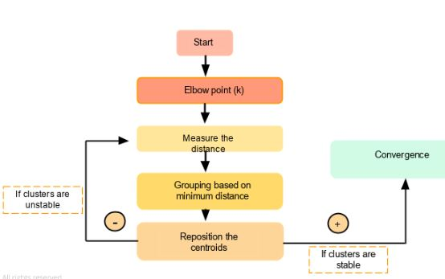

Slide 15
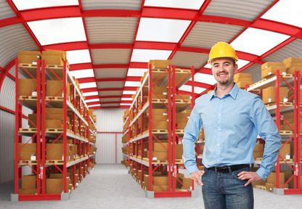
Imagine you're a manager at a factory, and you're responsible for organizing a warehouse full of different types of products. You want to arrange these products into different categories to make them easier to manage and locate.
Let us understand this in detail:
Choosing K (Number of Clusters):
First, you need to decide how many categories, or clusters, you want to organize your products into. This is like deciding how many shelves or sections you want to have in your warehouse. Let's say you decide on five clusters.
Initializing Cluster Centers:
Next, you randomly choose five spots in your warehouse to serve as the initial centers for your clusters. These spots will represent the centers of your categories.
Assigning Products to Clusters:
Now, you start assigning each product in your warehouse to the cluster whose center is closest to it. You might measure distance based on how far products are from each cluster center.

Slide 16
Updating Cluster Centers: After you've assigned all the products to clusters, you recalculate the center of each cluster based on the products assigned to it. Imagine physically moving the center of each cluster to the average location of all the products in that cluster.
Repeating Until Convergence: You keep repeating steps 3 and 4 until the cluster centers stop moving significantly. This means that each product is now assigned to the cluster whose center is closest to it, and the centers of the clusters have settled into stable positions.
Interpreting Clusters: Finally, you examine the products in each cluster to understand what they have in common. This helps you label each cluster with a meaningful category. For example, one cluster might contain all the electronics, while another might contain all the clothing items.
Calculations involved:
Distance Measurement: In the warehouse scenario, you might measure the distance between products and cluster centers using a simple method like straight-line distance (Euclidean distance) or any other suitable method based on your specific needs.
Center Recalculation: To update the center of each cluster, you calculate the average position of all the products currently assigned to that cluster. This new position becomes the updated center of the cluster.

Slide 17
How to choose “K”?
Selecting the right number of clusters, K, is a crucial step in K-means clustering. Here's a simplified explanation of how you can go about selecting K:
Elbow Method: Imagine plotting the sum of squared distances between each data point and its assigned cluster center (also known as the "within-cluster sum of squares" or "inertia") against the number of clusters (K). It's like plotting how tightly packed your products are in each cluster as you increase the number of clusters.
Start by trying out different values of K, maybe ranging from 1 to 10 or even higher, depending on your data and the problem.
For each value of K, perform K-Means clustering and calculate the sum of squared distances.
Plot these values on a graph.
Look for the point where adding more clusters doesn't decrease the sum of squared distances significantly. It's like finding the "elbow" point on the graph where the rate of decrease slows down abruptly. This point indicates a good balance between model complexity (number of clusters) and fit to the data.
For example, if you see a sharp decrease in inertia initially, followed by a gradual decrease, and then the rate of decrease levels off (forming an elbow shape), the number of clusters at the elbow could be a reasonable choice for K.

Slide 18
How to choose “K”?
Silhouette Score: Silhouette score measures how similar an object is to its cluster compared to other clusters. It ranges from -1 to 1, where a high value indicates that the object is well-matched to its cluster and poorly matched to neighboring clusters.
For each value of K, calculate the average silhouette score across all data points.
Plot the silhouette scores for different values of K.
Look for the highest silhouette score, which indicates the optimal number of clusters.
The higher the silhouette score, the more defined and well-separated the clusters are.
Domain Knowledge: Sometimes, domain knowledge about your data or the problem you're trying to solve can help you determine a reasonable range for K. For example if you're clustering customer data, you might already know from experience that there are typically three main customer segments based on their purchasing behavior.

Slide 19
Clustering Hierarchical Means

Slide 20
What is Hierarchical means?
Hierarchical clustering is another unsupervised machine learning algorithm, which is used to group the unlabeled datasets into a cluster and is also known as hierarchical cluster analysis or HCA.
In this algorithm, we develop the hierarchy of clusters in the form of a tree, and this tree-shaped structure is known as the dendrogram.
The dendrogram from hierarchical clustering reveals the hierarchy of clusters at different levels, highlighting natural groupings in the data. It provides a visual representation of the relationships between clusters, helping to identify patterns and outliers, making it a useful tool for exploratory data analysis.

Slide 21
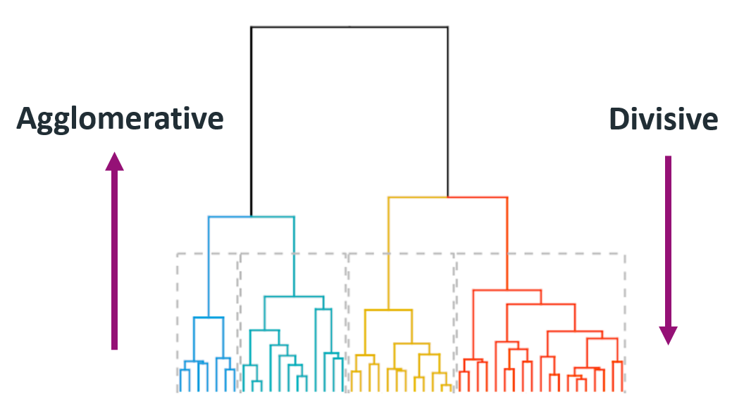
Types

Slide 22
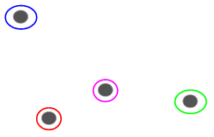
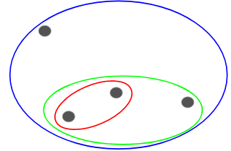
Agglomerative Clustering
We assign each point to an individual cluster in this technique. Suppose there are 4 data points. We will assign each of these points to a cluster and hence will have 4 clusters at the beginning:
Then, at each iteration, we merge the closest pair of clusters and repeat this step until only a single cluster is left:

Slide 23
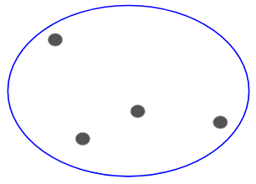
Divisive Clustering
Divisive Clustering Hierarchical works in the opposite way. Instead of starting with n clusters (in the case of n observations), we start with a single cluster and assign all the points to that cluster.
So, it doesn’t matter if we have 10 or 1000 data points. All these points will belong to the same cluster at the beginning:
Now, at each iteration, we split the farthest point in the cluster and repeat this process until each cluster only contains a single point:

